Slide 1

PARADISE TRAVELERS
PAKISTAN TOUR

Slide 2
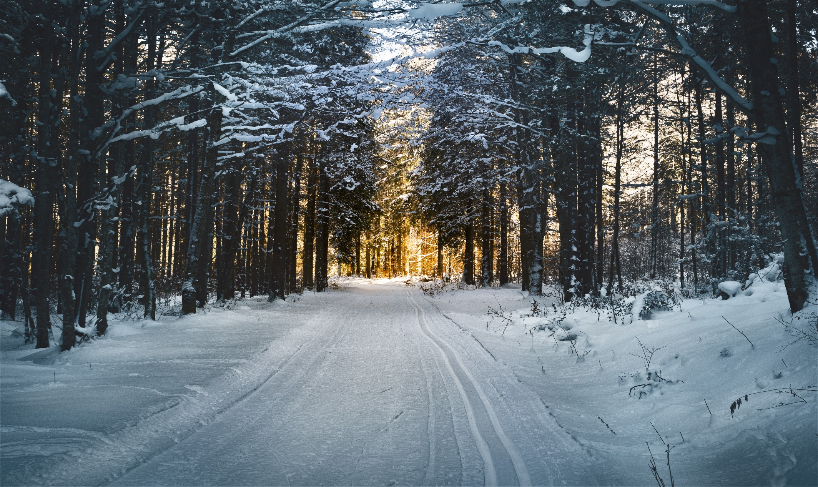
Pakistan's Best Places We Will Visit :
MURREE
SKARDU
NARAN KAGHAN
KASHMIR

Slide 3
You Only

